Slide 1
Microservices Patterns

Slide 2
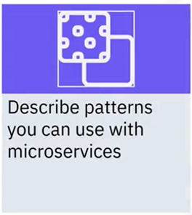
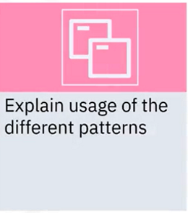
What you will learn

Slide 3
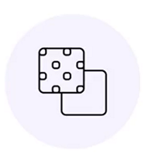
Patterns for microservices
Enable some of the more common challenges and opportunities
Examples:
• Single-page application (SPA)
• Backend for Frontend (BFF)
• Strangler
• Service discovery

Slide 4
Single page application (SPA)
• Enabled by more powerful browsers, faster networks, and
client-side languages
• Loads one interface that never reloads
• Updates dynamically using calls to backend REST-based
services
• Simplifies the front-end experience
• Places greater performance responsibility on backend services

Slide 5




Backend for Frontend (BFF)
• Provides superior support
compared to a generic
backend
• Inserts a layer between user
experience and the resources
• Enables customized user
experiences for different
channels
• Supports one backend type
per user interface

Slide 6
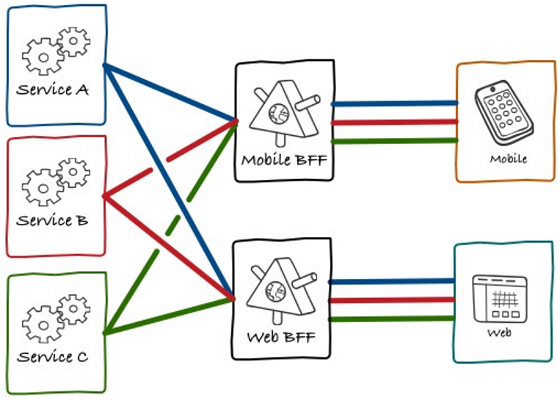
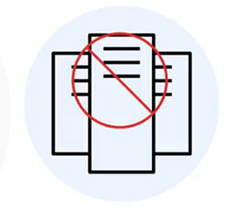
Backend for Frontend (BFF)

Slide 7

Strangler pattern
• Manages refactoring in stages
• Gets its name from a vine that strangles a tree
• Splits functional domains
• Replaces with new microservice per domain
• Enables two applications to exist side-by-side

Slide 8
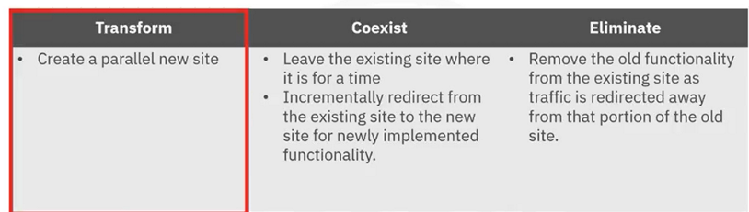
Strangler pattern

Slide 9

Service discovery
• Helps applications and
services discover each other
• Provides flexibility as service
instances can change
dynamically
• Could be used by load
balancers to perform health
checks and rebalance traffic
on service failures

Slide 10
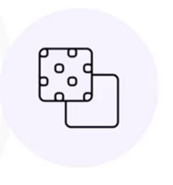
Other patterns
• Entity and aggregate patterns
• Example: e-commerce site
• Adapter patterns
• Help translate
relationships between
incompatible objects
• Example: integration with
third-party API

Slide 11
Recap
In this video, you learned that:
• Microservices enable single-page applications that rely on
backing services to update the page dynamically
• Backend for Frontend patterns use microservices to facilitate
different user experiences more easily
• You can apply the Strangler pattern to help break up monolithic
apps into microservices
• A service discovery pattern helps applications and services
discover each other

